Slide 1

CRM Analytics

Slide 2
1. Arti Gadhave
2. Pilli Venkata Dharani
3. Ninar Vennela
4. Mogasala Nihitha
5. Shivam Gupta
6. Muthe DevikaSai
7. Phalak Ahmed
Group Details

Slide 3
Summary
Analyzes lead and opportunity data to understand the complete sales pipeline.
Tracks key metrics such as lead sources, lead stages, conversions, active opportunities, and win rate.
Identifies high-performing lead sources, industries, and sales outcomes.
Highlights gaps in lead conversion and opportunity follow-up.
Supports data-driven decisions to improve sales efficiency and revenue growth.

Slide 4
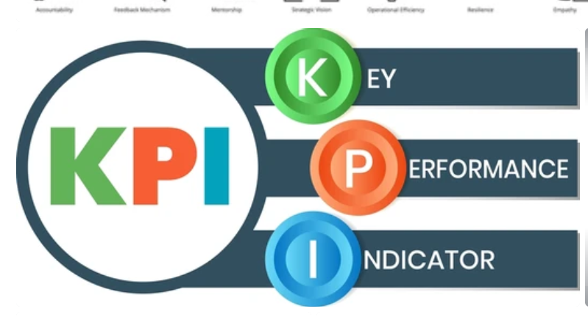

Slide 5
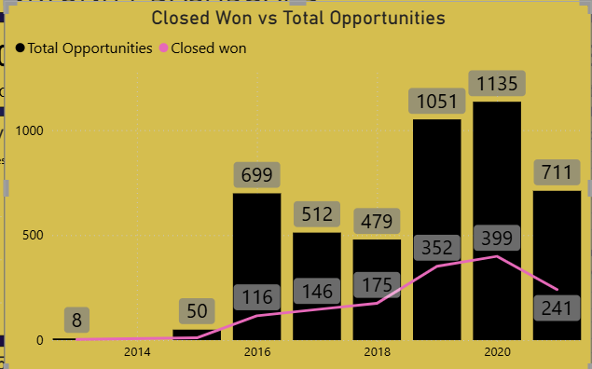
Compares total opportunities created with successfully closed-won deals over time.
Shows growth in total opportunities, indicating strong pipeline creation.
Highlights the gap between opportunities and wins, pointing to conversion improvement areas.
Helps track sales effectiveness and win-rate trends.

Slide 6
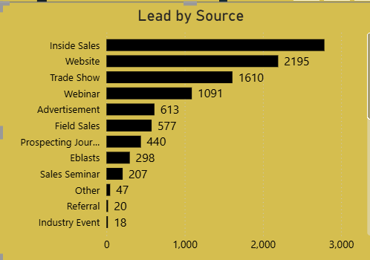
The chart shows distribution of leads across different acquisition channels.
Identifies top-performing lead sources contributing maximum leads.
Helps evaluate marketing and sales channel effectiveness.
Supports better budget allocation and lead generation strategy.

Slide 7
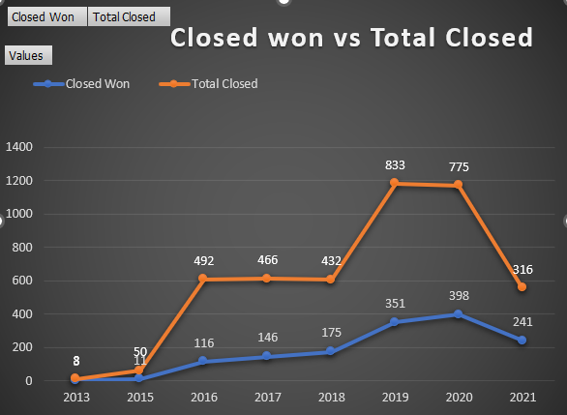
Compares total closed opportunities with successfully won deals over time.
Shows a steady increase in closed-won opportunities, indicating improving sales performance.
Highlights the gap between total closures and wins, helping analyze win efficiency.
Supports tracking sales trends and forecasting future revenue.

Slide 8
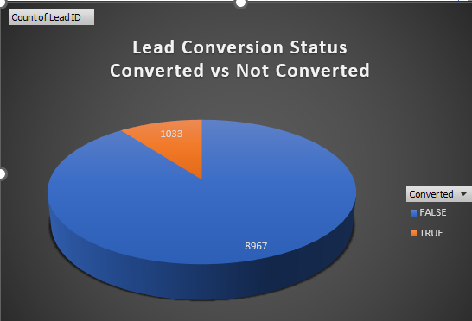
The chart shows the overall split between converted and non-converted leads.
Highlights that a large portion of leads remain unconverted, indicating conversion gaps.
Helps evaluate the effectiveness of lead nurturing and follow-up process.
Supports identifying opportunities to improve lead qualification and conversion rate.

Slide 9
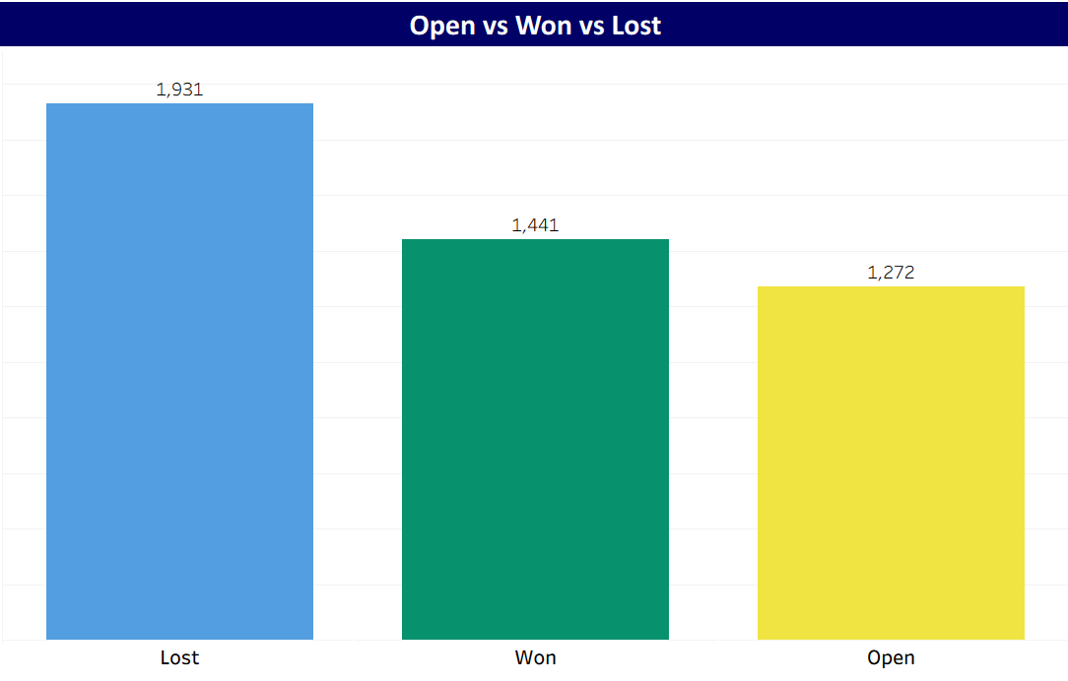
The chart shows the distribution of opportunities across Open, Won, and Lost stages.
Highlights that lost opportunities are higher than won, indicating conversion improvement areas.
Helps evaluate overall sales performance and pipeline effectiveness.
Supports analysis of follow-up strategy to increase win rate and reduce losses.

Slide 10
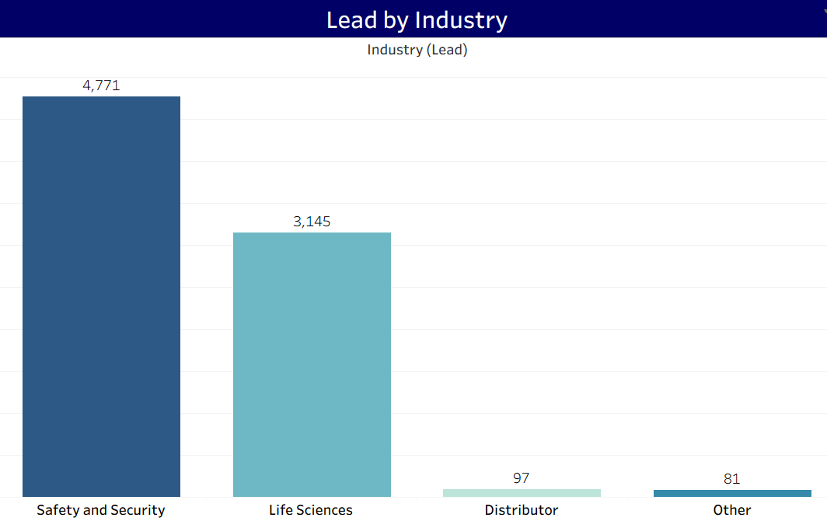
The chart shows distribution of leads across different industries.
Identifies industries generating maximum leads.
Highlights key focus industries for sales efforts.
Helps prioritize industry-specific marketing strategies.

Slide 11
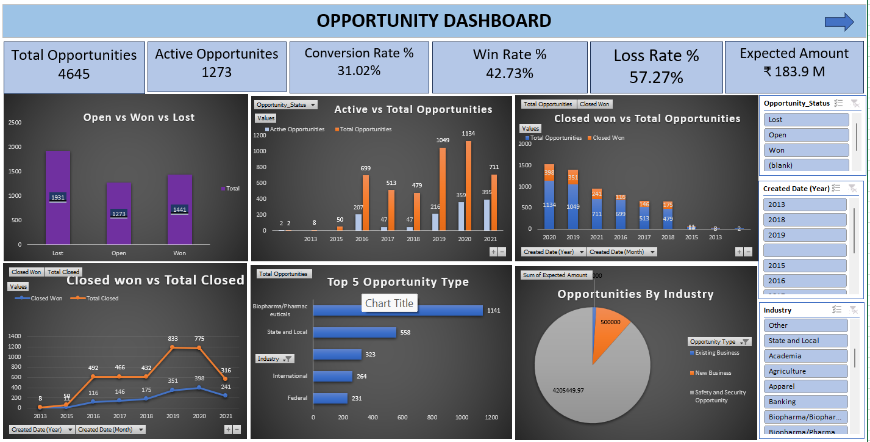
Excel Opportunity Dashboard

Slide 12
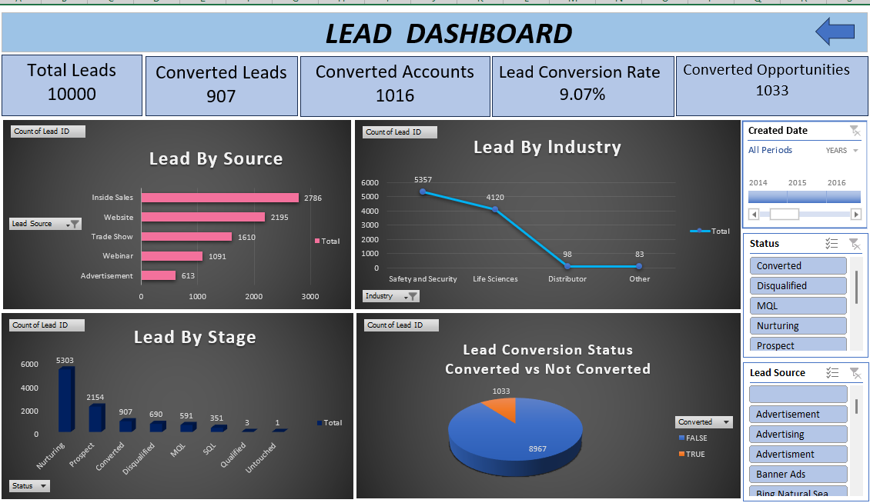
Excel Lead Dashboard

Slide 13
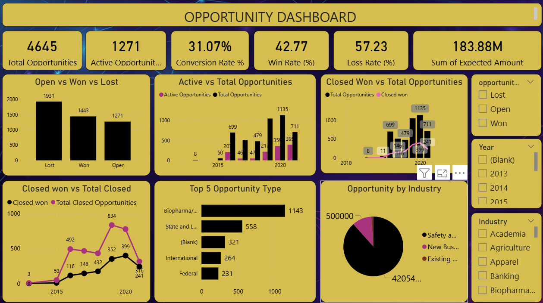
Power BI Opportunity Dashboard

Slide 14
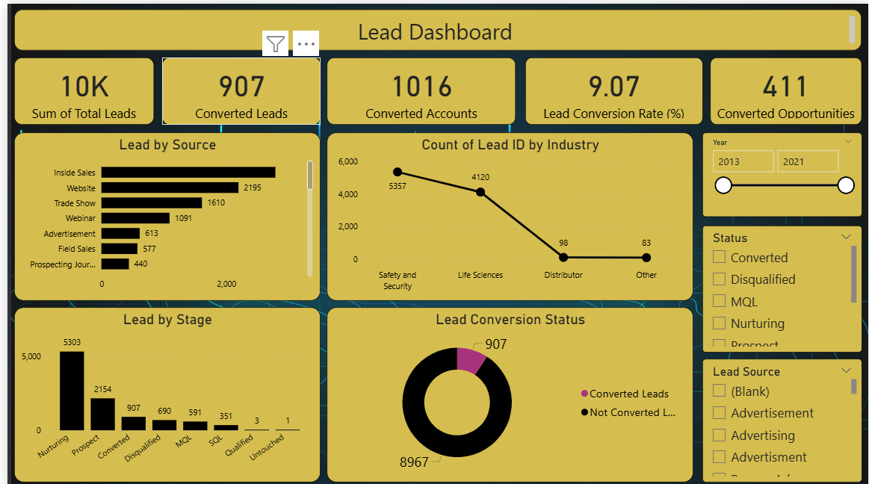
Power BI Lead Dashboard

Slide 15
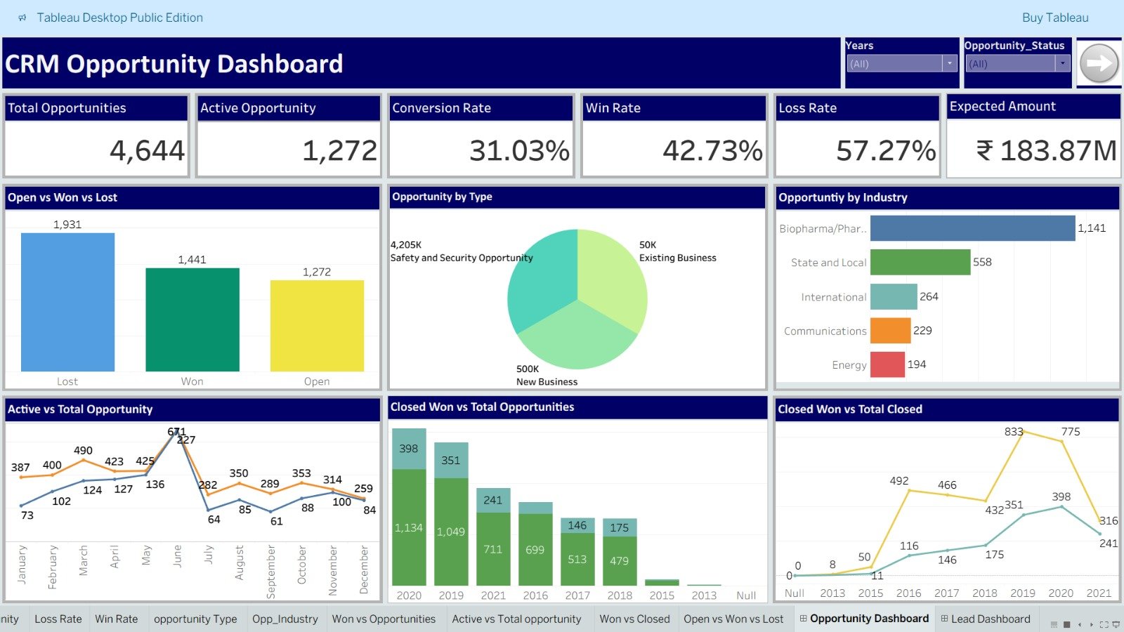
Tableau Opportunity dashboard

Slide 16
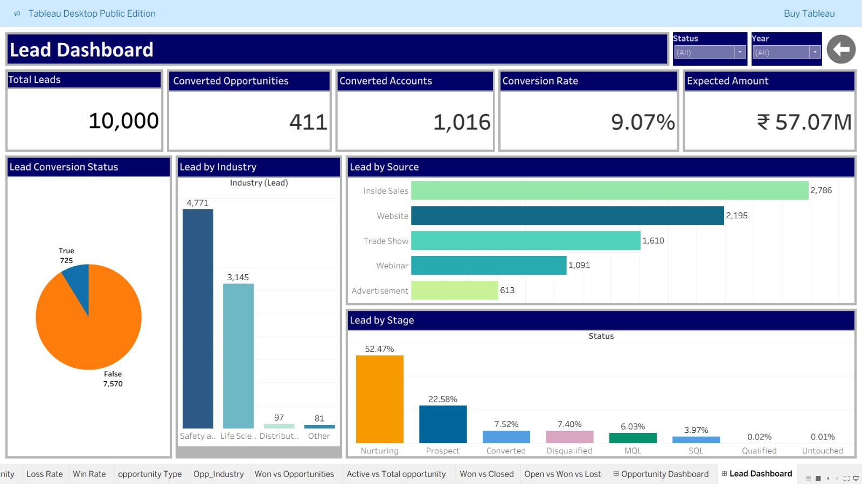
Tableau Lead Dashboard

Slide 17
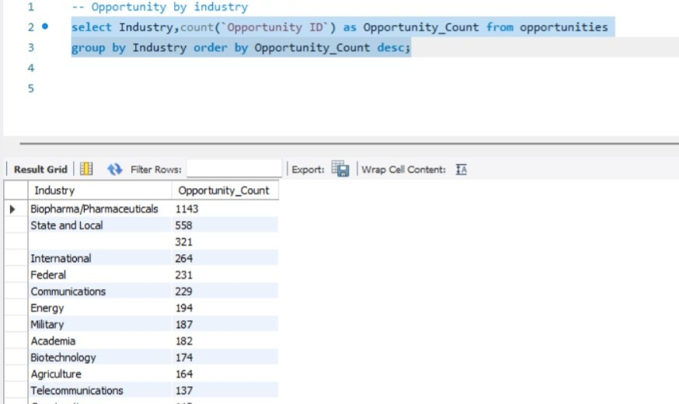
Opportunity By Industry
This query groups opportunities by industry and ranks them by opportunity count to identify top-performing industries.

Slide 18
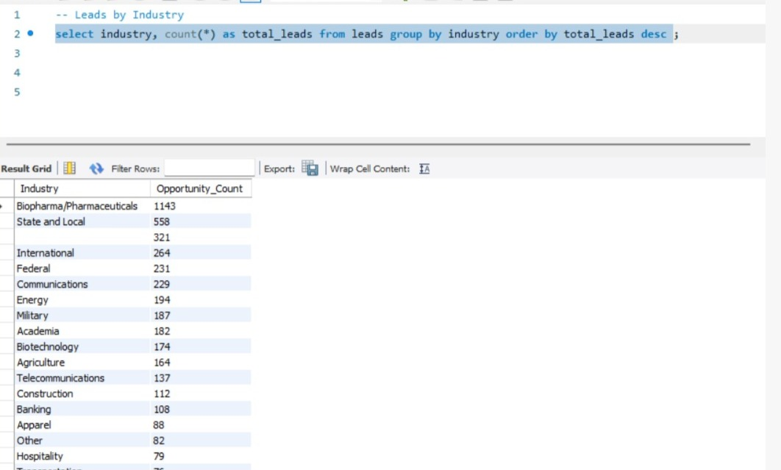
Lead By Industry
This query find industry-wise lead count to identify industries generating the highest number of leads.

Slide 19
Key Takeaways
Business Insights
Certain lead sources and industries generate higher quality leads.
A clear gap exists between total and active opportunities, impacting pipeline strength.
Conversion rates and win trends highlight overall sales efficiency.
Challenges
Lead drop-offs observed at specific stages of the sales funnel.
Lower engagement on some created opportunities.
Inconsistent performance across lead sources and industries.
Future Recommendations
Focus marketing efforts on high-performing lead sources and industries.
Improve follow-up strategies to increase active opportunities and win rate.
Strengthen lead nurturing at critical funnel stages to improve conversions.

Slide 20
Conclusion
The CRM Analytics project provides a unified view of the entire customer lifecycle, from lead generation to opportunity conversion and revenue analysis.
Interactive dashboards with KPIs, charts, and slicers enable quick and accurate performance tracking, helping stakeholders make informed, data-driven decisions.
The analysis highlights key business insights such as conversion efficiency, pipeline health, and industry-wise performance, allowing teams to identify strengths and improvement areas.
Overall, the project demonstrates how CRM data can be effectively transformed into actionable insights, supporting sales optimization, better forecasting, and long-term business growth.

Slide 21

Thank You

